Slide 1
GUI PROGRAMMING
Benjamin Jakimow
EnMAP-Box Workshop, 26.02.2019, Berlin

Slide 2

Graphical User Interfaces
visual frontends
human-machine interaction
direct manipulation of graphical elements
Make hardware/software usable
for programmers users

Slide 3
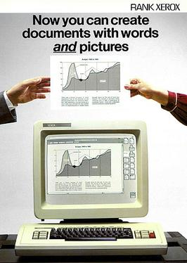
History
1981: The first commercial system with a window-based GUI
Xerox Star (Xerox 8010 Information System)

Slide 4
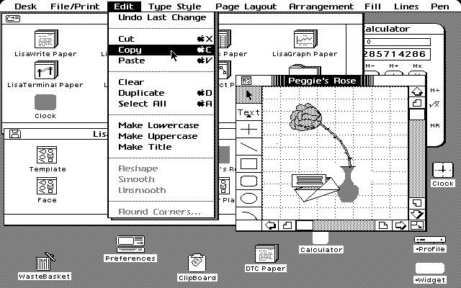
History
1983: Apple Lisa, the first home computer with a GUI https://www.mac-history.net/apple-history-2/apple-lisa/2007-10-12/apple-lisa

Slide 5
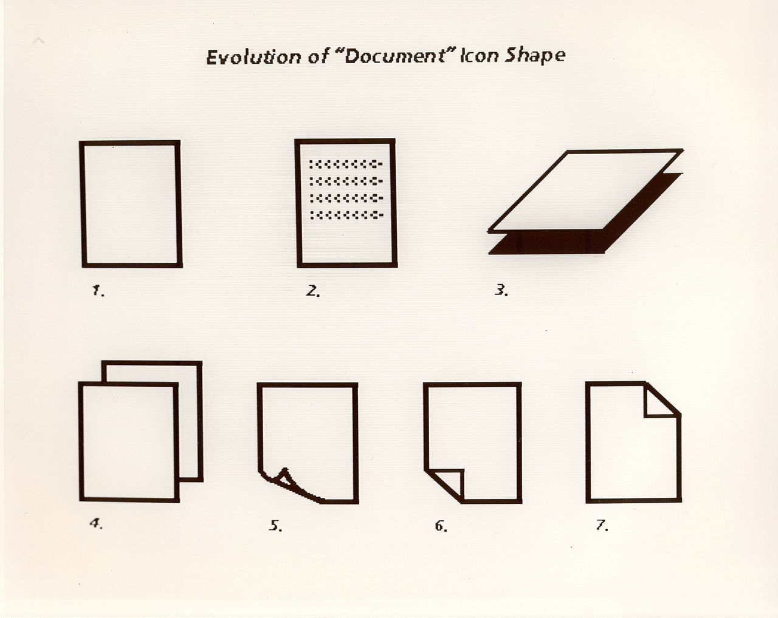


Icons
QGIS „mIconFile.svg“
Evolution of Xerox Star document icon
https://en.wikipedia.org/wiki/Xerox_Star
Another icon

Slide 6
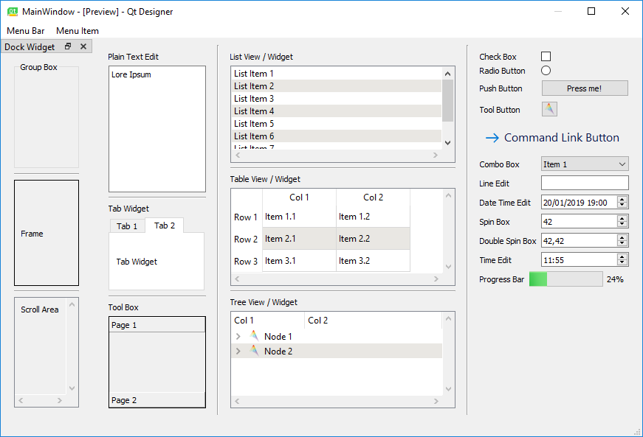
Widgets
visual elements of interaction
Notes:
not shown: tooltips, cursors, ...

Slide 7
Good UI Design
reduces the number of required user-interactions
intuitive and well-structured
good user-interfaces can be used without manuals
pick-up known concepts
similar tasks known from other software?
responsive
resizability, mouse cursors

Slide 8

Runtime
Standard Thread
1. Start
2. Process
3. Terminate
GUI Thread
1. Start
2. Event?
No: wait (idle)
Yes: process
Yes: terminate
3. Terminate
Notes:
This is the case e.g. in a CLI, Spyder, PyCharm that waits for your input

Slide 9

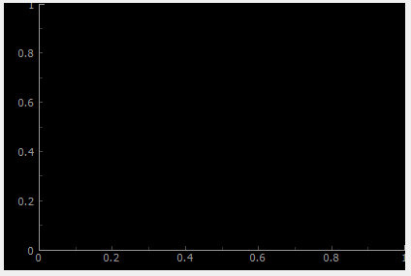
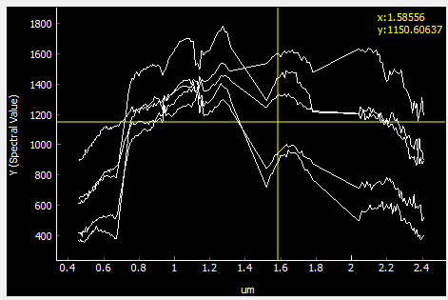
Object-oriented programming (OOP)
methods + properties
more methods + properties
QWidget
QFrame
QAbstractScrollArea
QGraphicsDisplay
pyqtgraph.PlotWidget
qps.speclib.plotting.SpectralLibraryPlotWidget
Notes:
„window gadgets“

Slide 10

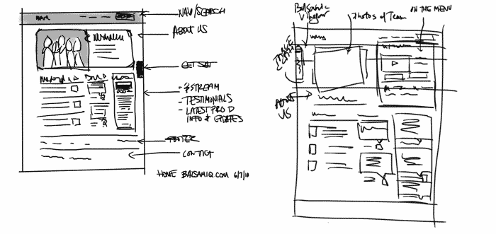
How to start?
identify the application purpose
What will the application be used for? Inputs/Outputs?
take the users perspective
Who will use the application? experts/beginners?
draft the frontend
Draw sketch maps, do not code!

Slide 11
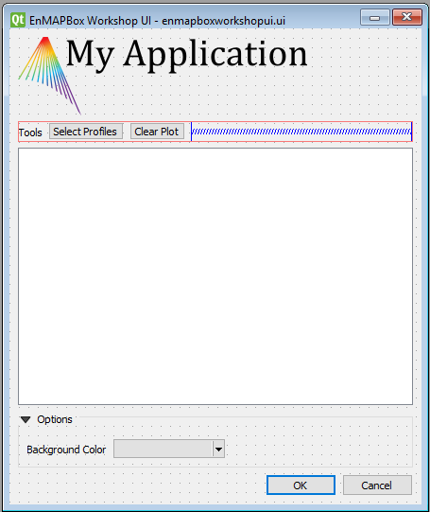
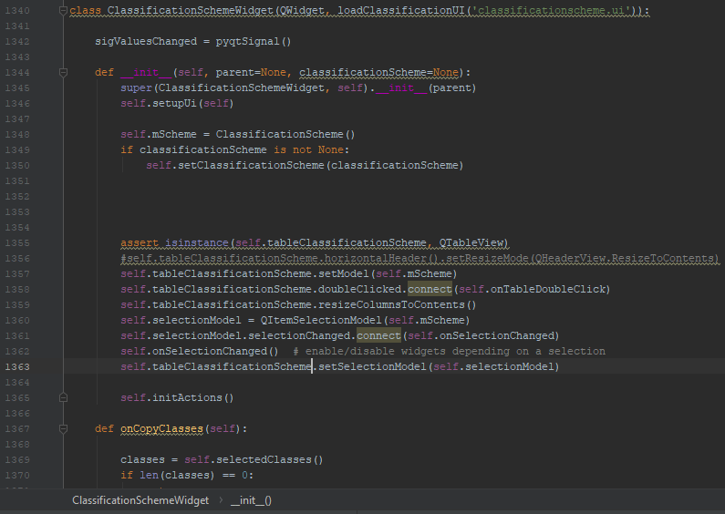
How to start?
implement the frontend
what users will see
write the backend
response to user inputs and processing events

Slide 12
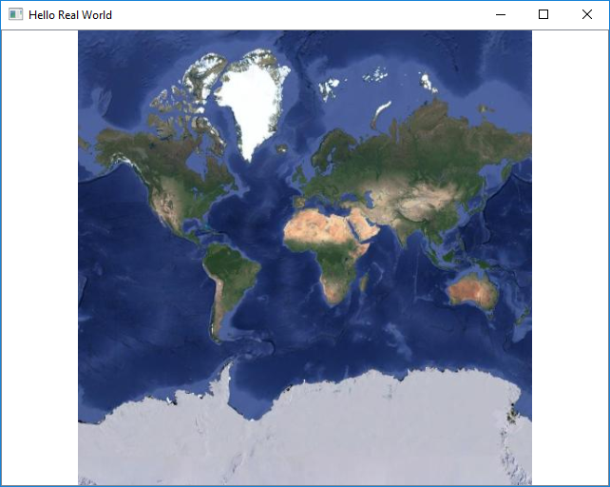
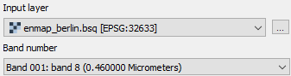
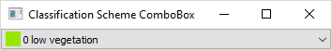
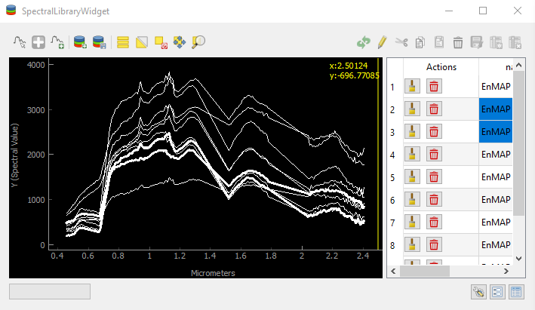
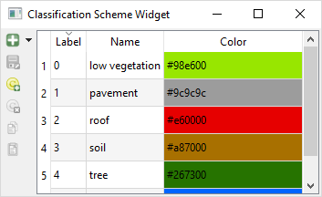
Use existing functionality
QgsMapLayerComboBox + QgsRasterBandComboBox
QgsMapCanvas
enmapbox.gui.ClassificationSchemeWidget
enmapbox.gui.SpectralLibraryWidget
enmapbox.gui.ClassificationSchemeComboBox
Notes:
widgets can be complex forms

Slide 13

Qt („cute“)
www.doc.qt.io
C++ API + PyQt
everything available in Qt can be used from Pyth
cross-plattform
FOSS, mature, many tools

Slide 14
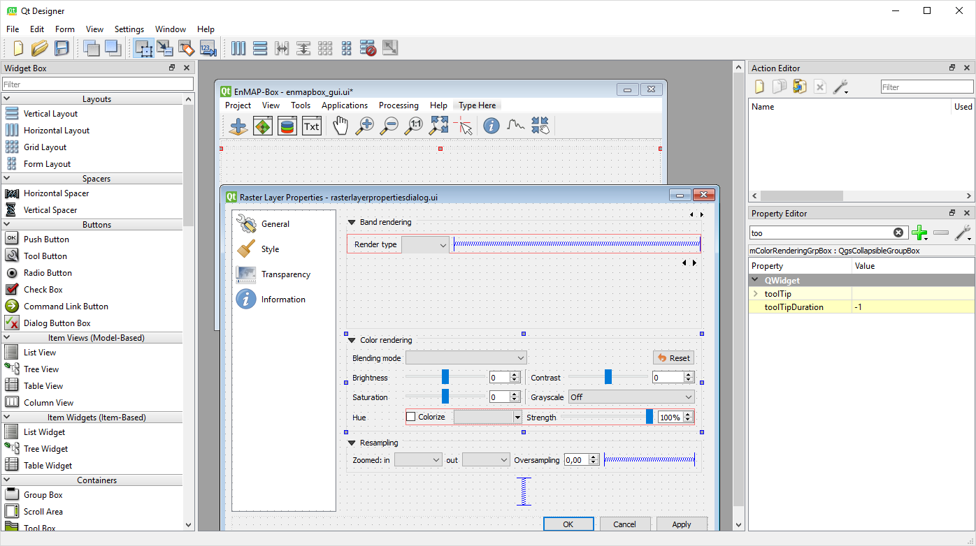
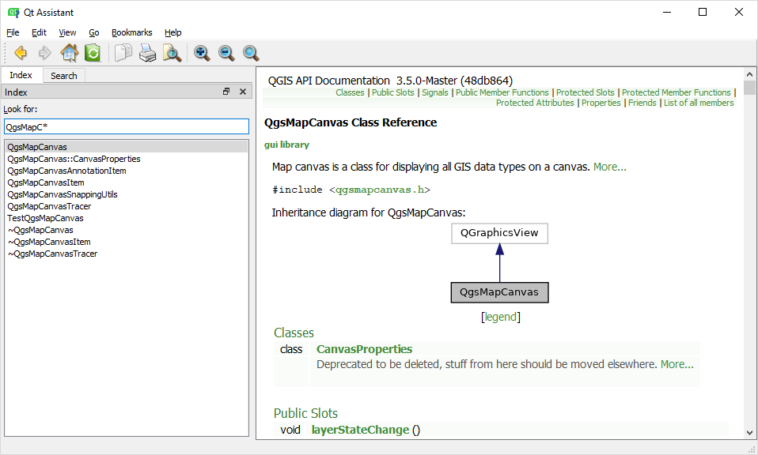
Qt Designer & Qt Assistant

Slide 15
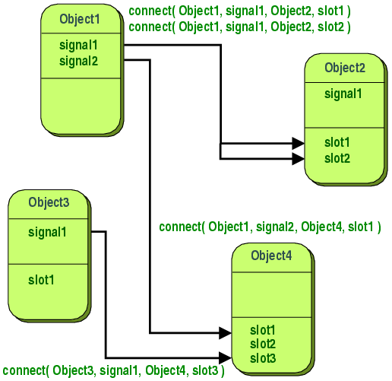
Signals & Slots
https://doc.qt.io/qt-5/signalsandslots.html
Notes:
This is the case e.g. in a CLI, Spyder, PyCharm that waits for your input

Slide 16
Signals & Slots
class ExampleWidget(QWidget):
sigButtonClicked = pyqtSignal()
def __init__(self, parent=None): super(ExampleWidget, self).__init__(parent) # connect signal 'clicked' with slot 'onButtonClicked' self.button.clicked.connect(self.onButtonClicked) # emit own signals self.button.clicked.connect(
lambda: self.sigButtonClicked.emit()) def onButtonClicked(self, *args): print('Button clicked')
Signal
Slot
Notes:
This is the case e.g. in a CLI, Spyder, PyCharm that waits for your input

Slide 17
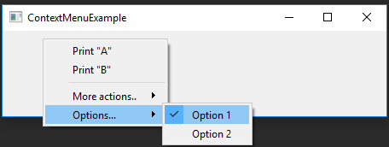
Event Handler
def contextMenuEvent(self, event: QContextMenuEvent):
menu = QMenu() action1 = menu.addAction('Print "A"') action1.triggered.connect(lambda: print('A')) . . . menu.exec_(event.globalPos())
Notes:
This is the case e.g. in a CLI, Spyder, PyCharm that waits for your input

Slide 18
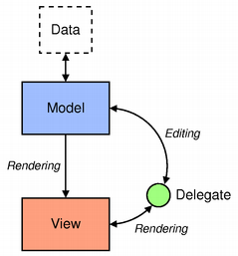
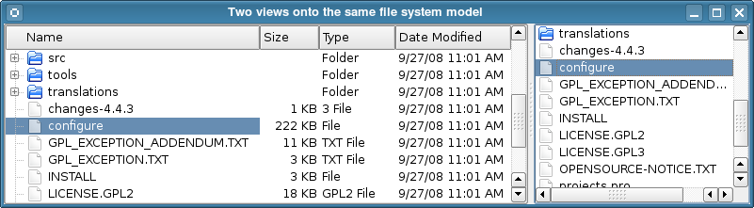
Qt Model-View Programming
Don‘t change data just to visualize it!

Slide 19

QGIS
freen and open source
GNU GPL-2, Open Geospatial Foundations
based on Qt, PyQt API
horray!

Slide 20
PyQtGraph
www.pyqtgraph.org
why do we use pyqtgraph?
speed, pure-python package, rapid-gui development, interactivity

Slide 21
Qt Charts?
model – view concept
by now not in QGIS ☹

Slide 22
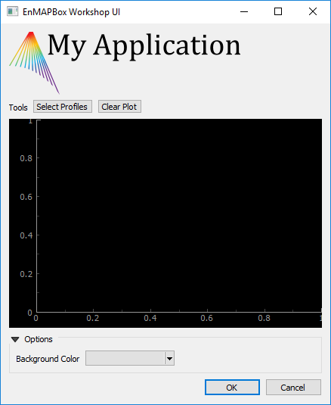
Programming Tutorial 2
14:00 ( “black“, room 1‘231) , 16:15 („blue“, room 1‘230)
Part I: Basics
From „Hello World“ to Qt Designer
Part II: EnMAP-Box Applications
Bring your application into the EnMAP-Box and interact with
Part III: Advanced Topics
Spectral Libraries, Classification Schemes,
AMA (ask me anything)

Slide 23
Thanks for your attention

Slide 24
